Slide 1
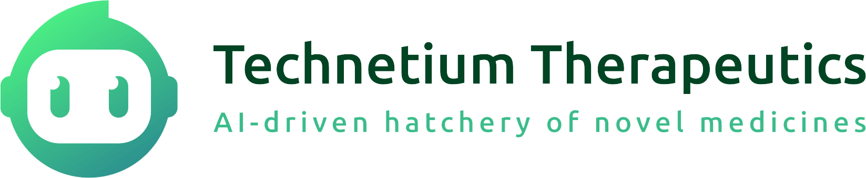
The Founders
Re-inventing the Process How Drugs Are Invented
Our Platform: AI Drug Design, DRUG-seq and Lab Automation
Our Pipelines, Clinical Differentiation Strategy and Business Strategy
Technetium THERAPEUTICS
April 2025

Slide 2
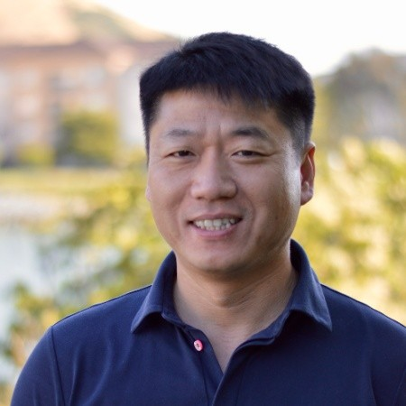
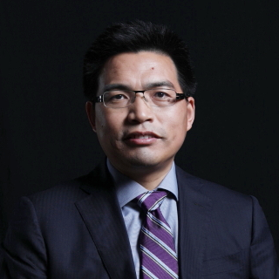
We Are Domain and AI Experts
Cheng Hu
Chunlin Wang
Co-Founder, CEO
Co-Founder, CTO
Director of medicinal chemistry and team lead for over 10 drug discovery projects
Co-lead of Atomwise AI model development to support drug discovery projects
Founder of several successful companies in the biotech industries
Inventor of several innovative algorithms that have become industry standards
Technetium Therapeutics founders are biotech industry veterans who are at the forefront of AI applications

Slide 3



Invent Novel Medicines, Much Faster
Our proprietary AI Agentic Workflow generates novel chemotypes, enabling the development of innovative drugs with superior clinical performance
By integrating Drug-Seq into the drug development process, we can optimize drug candidates, reduce costs, and improve the success rates of novel medicines
Incorporating automation into the drug development process, particularly in lead optimization, can significantly accelerate drug development
Technetium Therapeutics is leveraging AI, DRUG-seq and automation to develop best-in-class, novel medicines

Slide 4
Our AI-Driven Drug Design Process
Lead Design and Validation
8-12 weeks
$30-50K
Lead Optimization (PCT Filing）
12-16 weeks
$100-200K
Candidate Selection
6-9 months
$1-2 millions
IND Enabling
6-9 Month
$2-3 millions
AI-driven drug design reduces both cost and time of drug development by more than 50%

Slide 5
Our AI-Driven Lead Design Workflow
Our data-based AI design agent and reasoning AI review Agent operate in tandem
Running iterations can solve complex problems one step at a time
Human expertise provides a guardrail in each round of iteration
AI Agentic Workflow
Distillation
AI Review Agent
AI Design Agent
We are developing a proprietary AI-driven agentic workflow to discover novel leads
Design Instructions

Slide 6
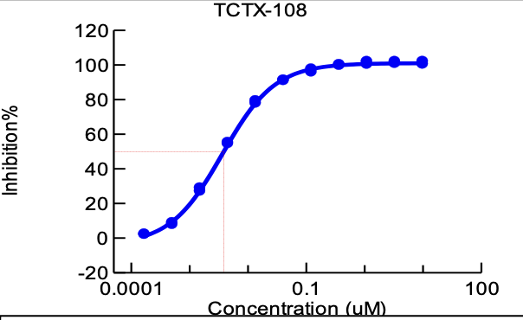
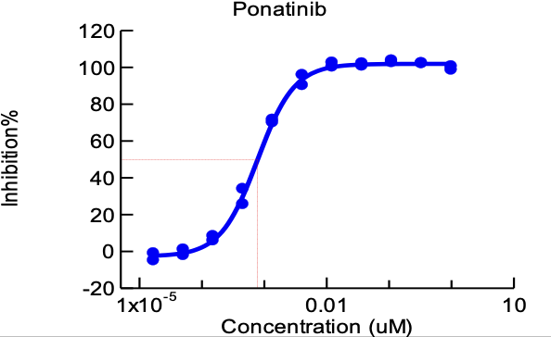
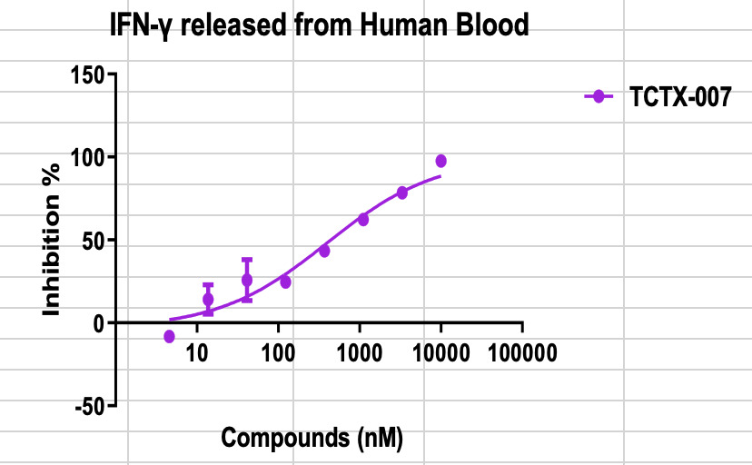
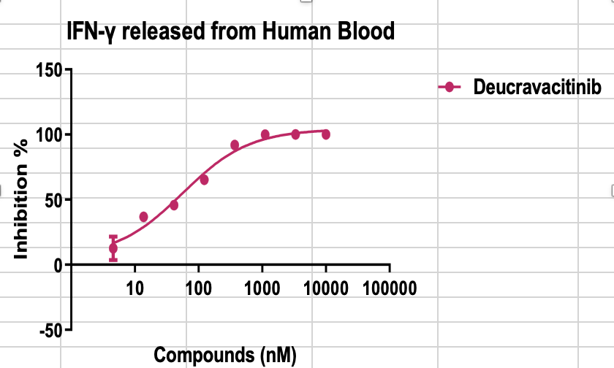
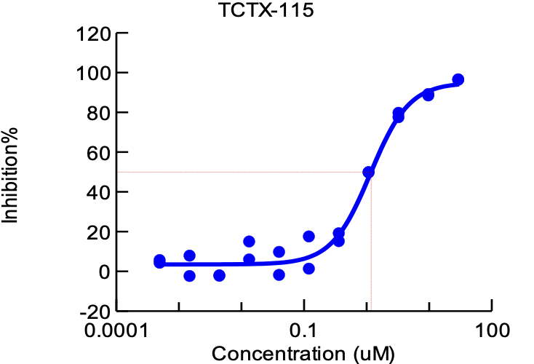
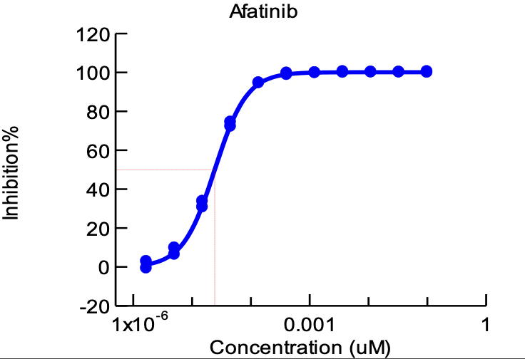
Validation of Our Design Platform
TCTX Lead
Approved Drug
CNS Penetrant c-Abl inhibitor
(Patent pending)
Gut-restricted TYK2 inhibitor
(Patent pending)
CNS Penetrant EGFR mutants inhibitor
Our platform has demonstrated the capability to design novel, candidate-like lead compounds

Slide 7
Our AIDD Labs
The high throughput, high dimension and high-quality DRUG-seq data generated from our AIDD Labs will accelerate the development of novel medicines
Fast iteration leads to greater efficiency and superior models
Our AI labs automate synthesis and assays, slashing iteration time by over 70%
AI-Driven Iteration
New Data
AI Workflow
AIDD Labs
The combination of our AI Labs and AI Design capabilities can significantly improve lead optimization efficiency
New Designs

Slide 8
Our Pipelines
Oncology
Our Lead Optimization Projects
Gut-restricted TYK2 inhibitors for IBD (in vivo validation)
CNS penetrant c-Abl inhibitors for neuron degenerative diseases (in vivo validation)
CNS penetrant BCR-Abl inhibitors for CNS relapse of AML
CNS penetrant EGFR mutants inhibitors (non-small cell lung cancer)
Our pipelines at Technetium Therapeutics center on key immunology, CNS and oncology diseases

Slide 9



2025-2026 Finance and Business Plan
Non-dilutive funding - $700,000: build AI-Labs and high throughput genomic profiling labs
Team Building: Expanding our team to 8-10 employees to productionize AI agentic workflows and optimize lead operations
Equity investments - $10-15 million: Scaling to 10 LO projects, among them 2 clinical development candidate will be nominated
Efficient capital deployment is crucial for creating a productive hatchery of novel medicines

Slide 10
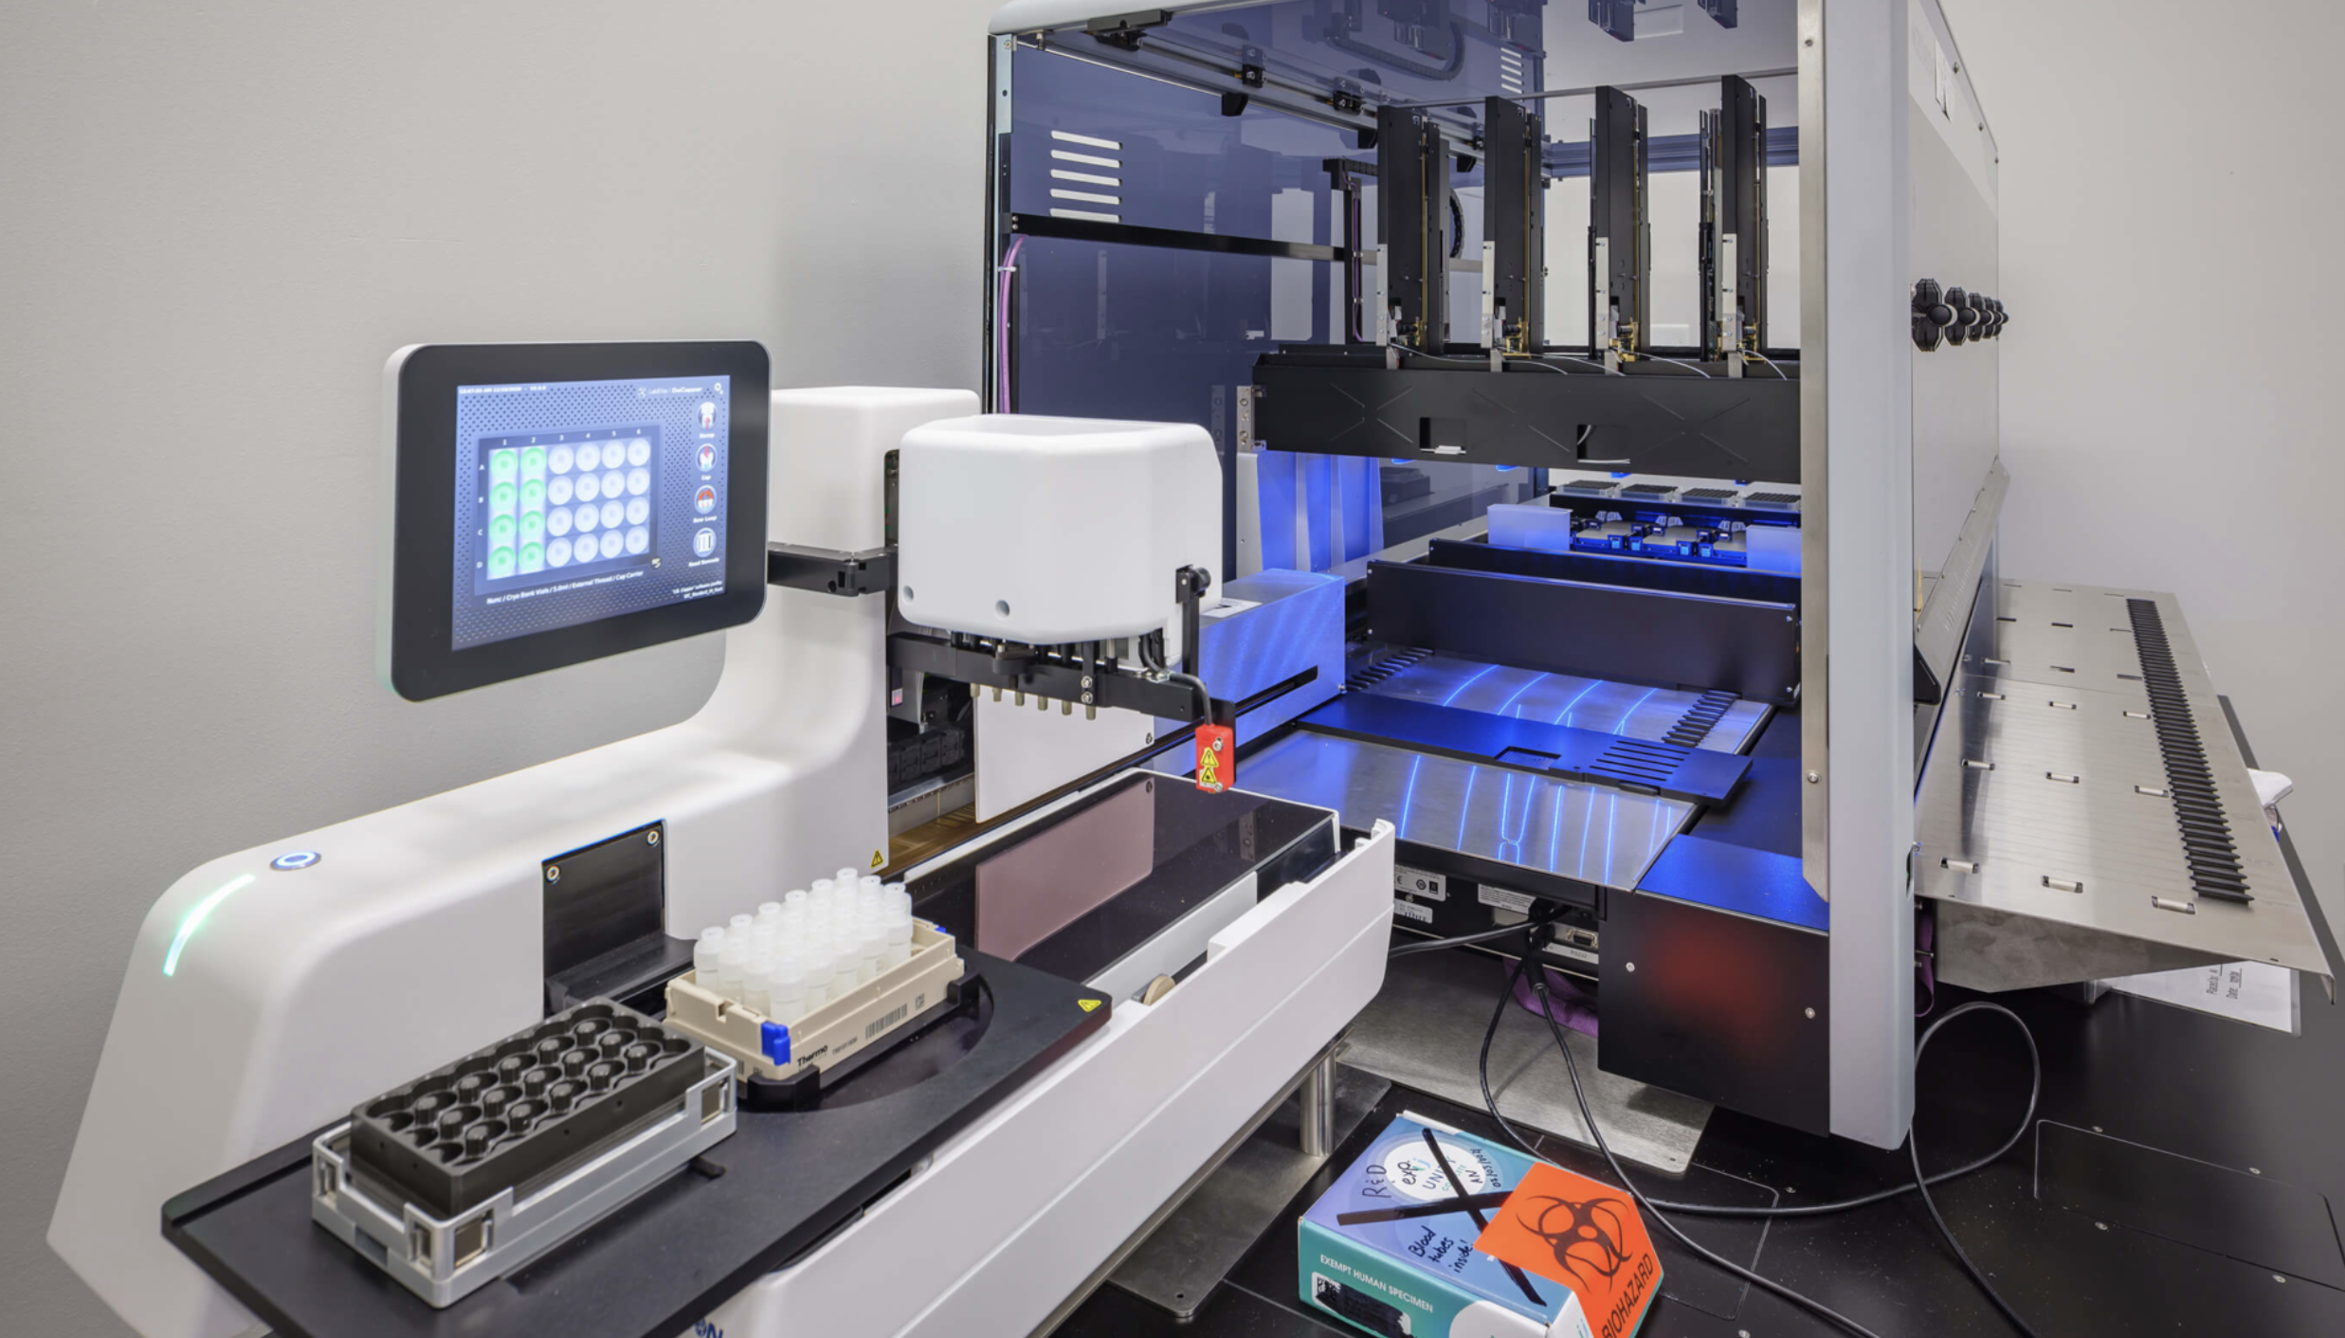
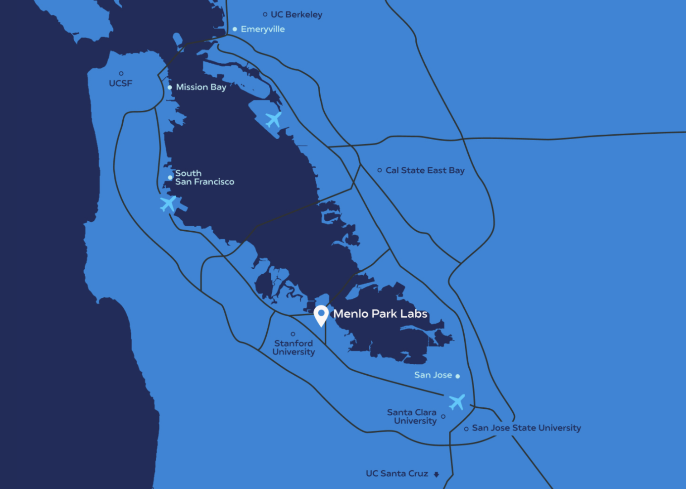
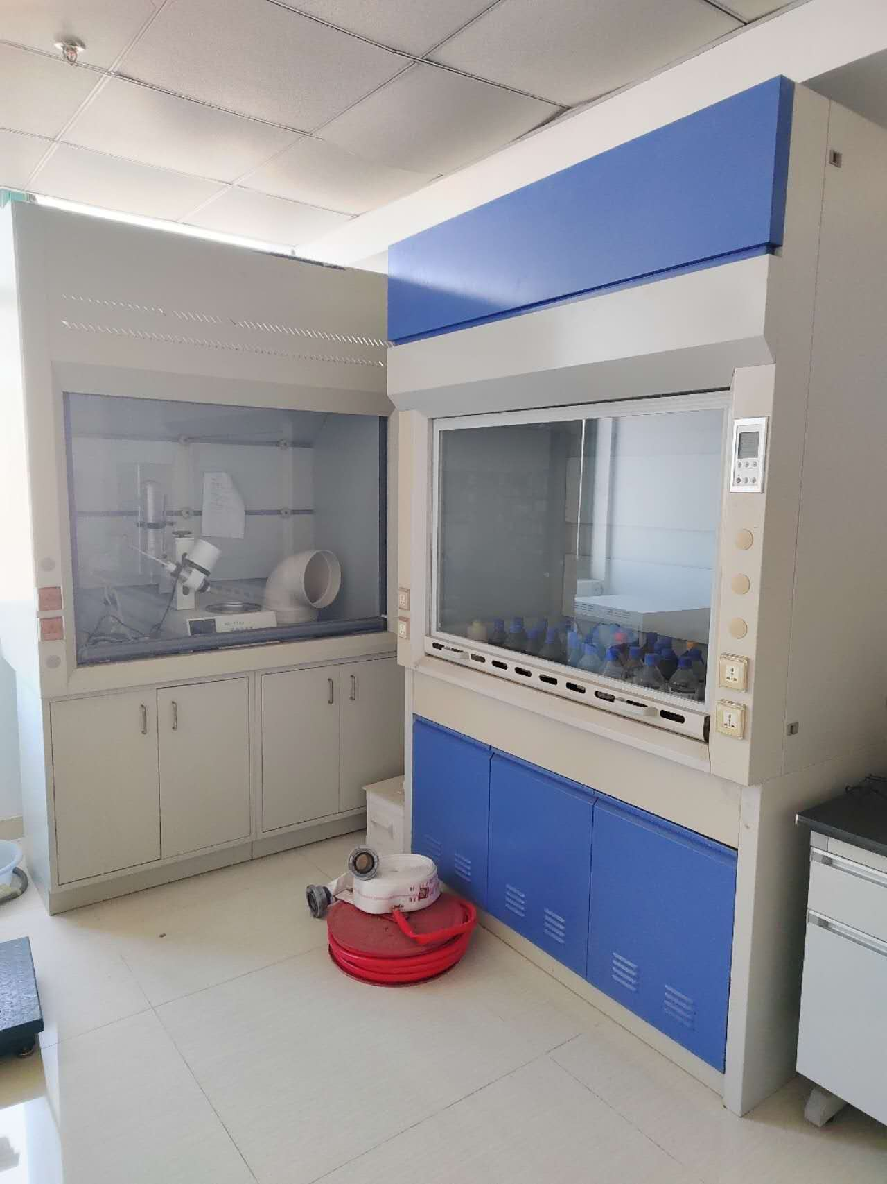
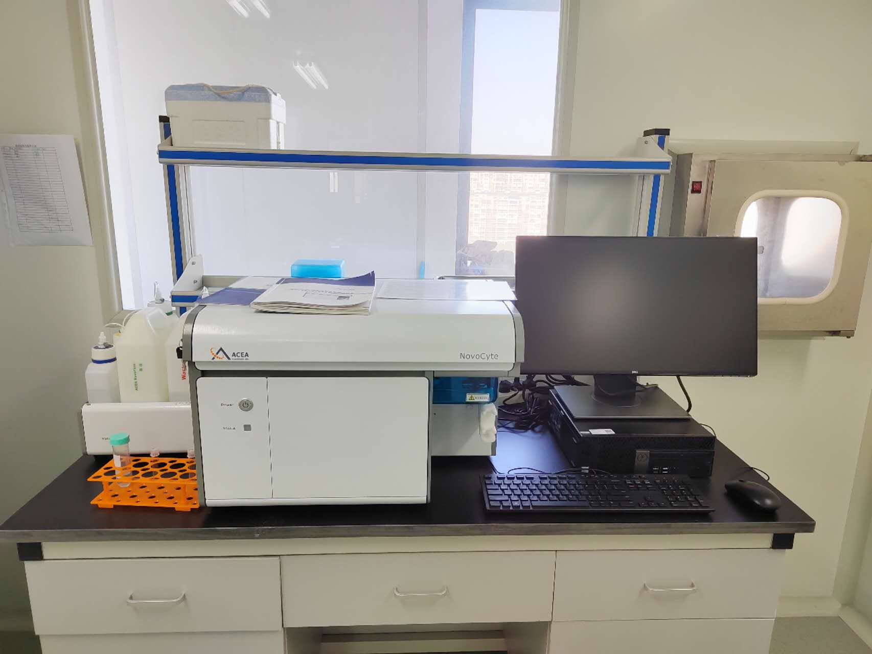
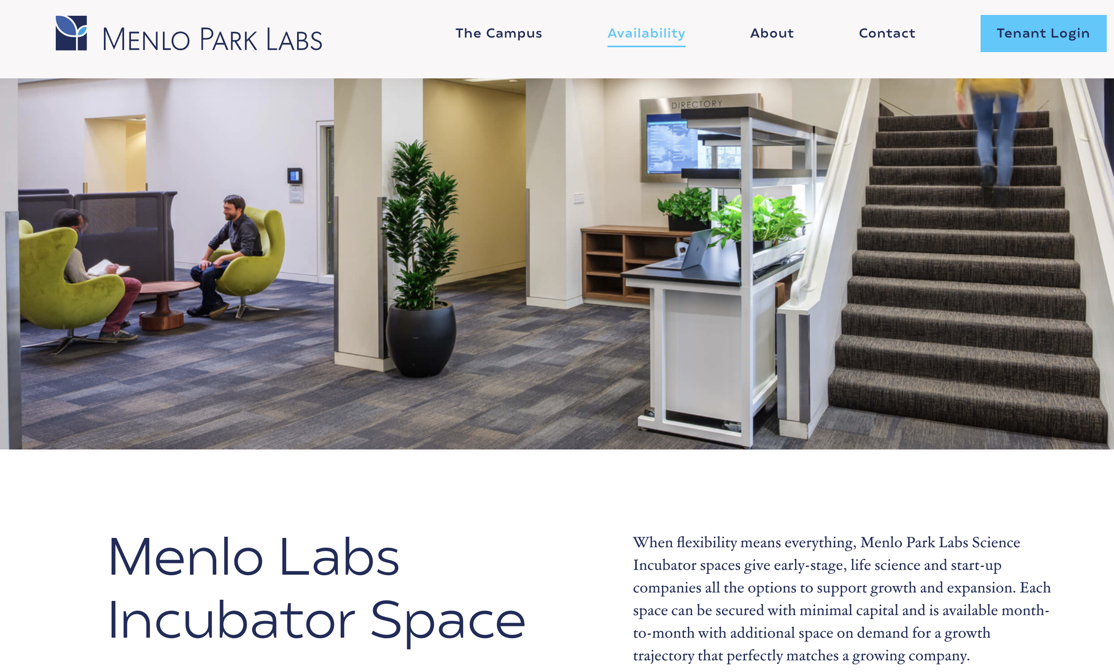
Our Current Facility
Menlo Park, our home, is the epicenter of the AI revolution and drug discovery breakthroughs

